Slide 1
What to expect when you’re consulting
Dropwizard demo with clean coding practices

Slide 2
Why this topic?
Intro to new consultants
(demo of clean coding in practice)
Something not too boring for existing consultants (who are all clean coding wizards)
Some selfish reasons

Slide 3
Why Dropwizard?
Dropwizard is a Java framework for developing ops-friendly, high-performance, RESTful web services.
Lightweight (ideal for microservices)
Best of breed libs
Forces good coding practices

Slide 4
Dropwizard - features
- Jetty : HTTP server.
- Jersey : RESTful web framework.
- Jackson : JSON library for the JVM.
- Metrics : for application metrics.
- Guava : Google’s excellent utility library.
- Logback : the successor to Log4j
- Hibernate Validator: for Bean Validation

Slide 5
Dropwizard - features contd.
- HttpClient, Jersey client
JDBI
Authentication for Basic, OAuth2

Slide 6
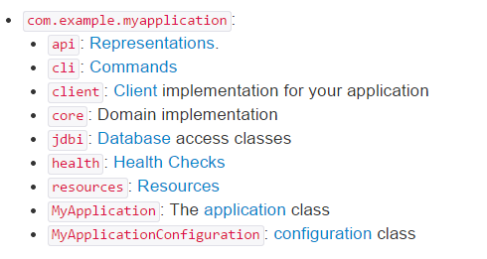
phraseFinder code (demo)
Runs from a jar (cloud deployment trivial)
Follows Dropwizard’s own packaging rules

Slide 7
phraseFinder code (demo) contd.
Single responsibility classes
Resource class acts like a controller
Service layer API implemented as interface
Service Impls are enums (singletons)
Builder for Responses

Slide 8
phraseFinder code (demo) contd.
Javadoc for exposed methods
No needless comments

Slide 9
phraseFinder code Improvements
Add a real repo (integrate with mongoDB)
  @see mongojack for mapping JSON(BSON) to POJOs
Add support for OWASP
  @see OWASP REST security cheat sheet
- Encrypt password in config file
Encrypt passwords

Slide 10
Additional delivery practices
- Confluence “living” documents
  Environment set up
  Esoteric concepts that are not easily understood from code or javadocs
  Release steps, notes, history
- Crucible peer review
- Confluence > Jira > crucible

Slide 11
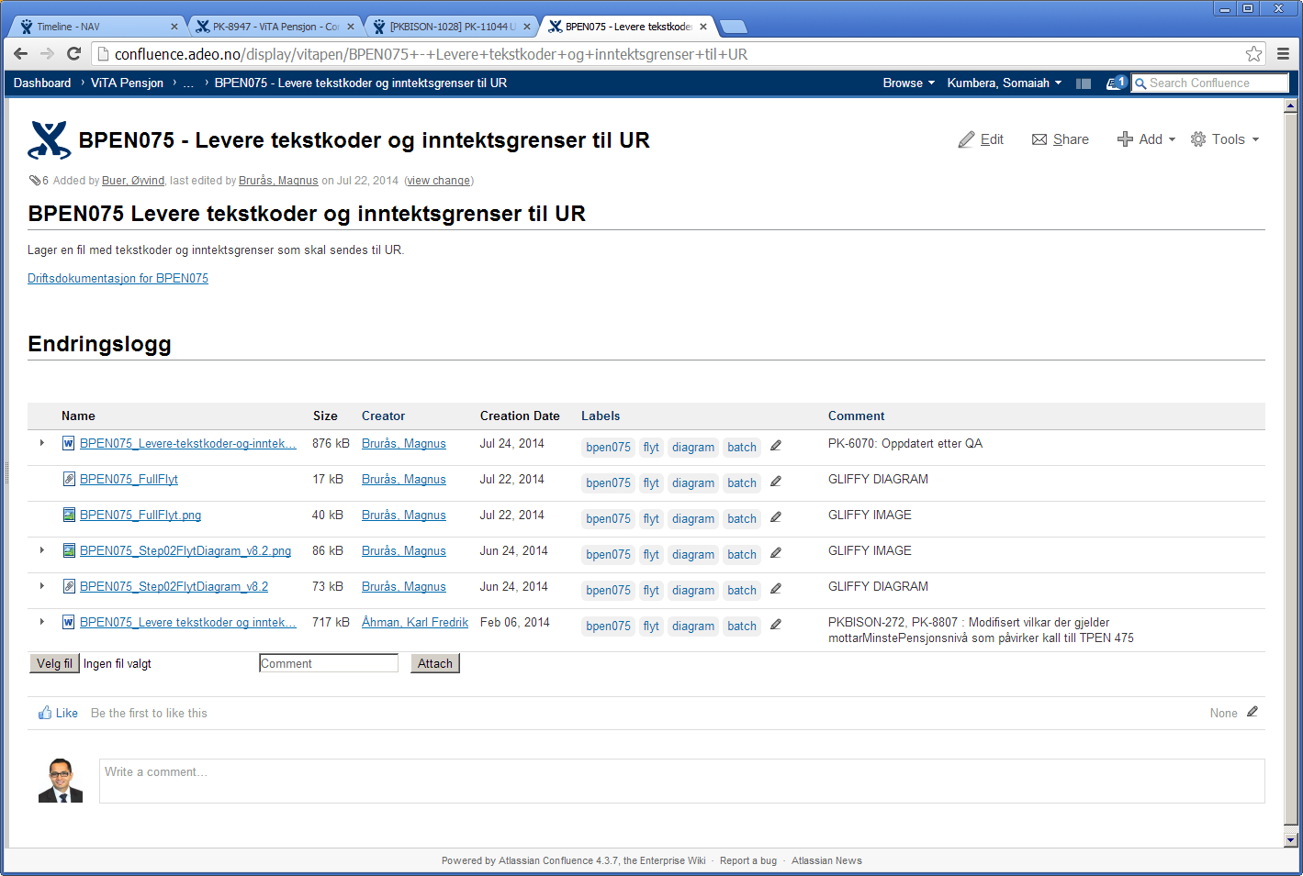
Additional delivery practices contd.
Confluence pic

Slide 12
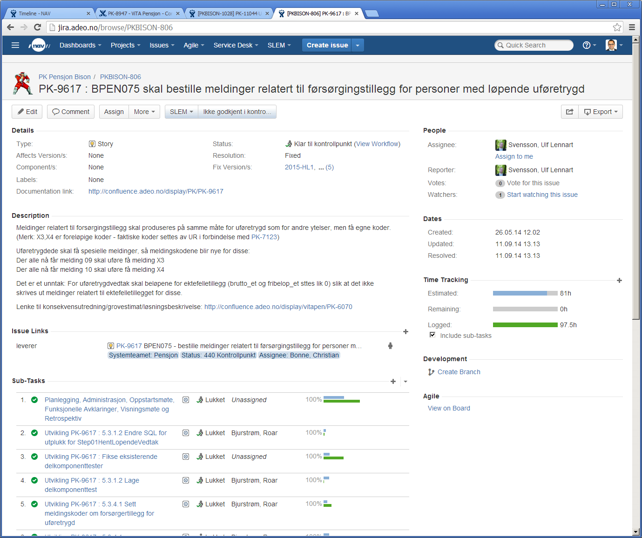
Additional delivery practices contd.
Jira pic

Slide 13
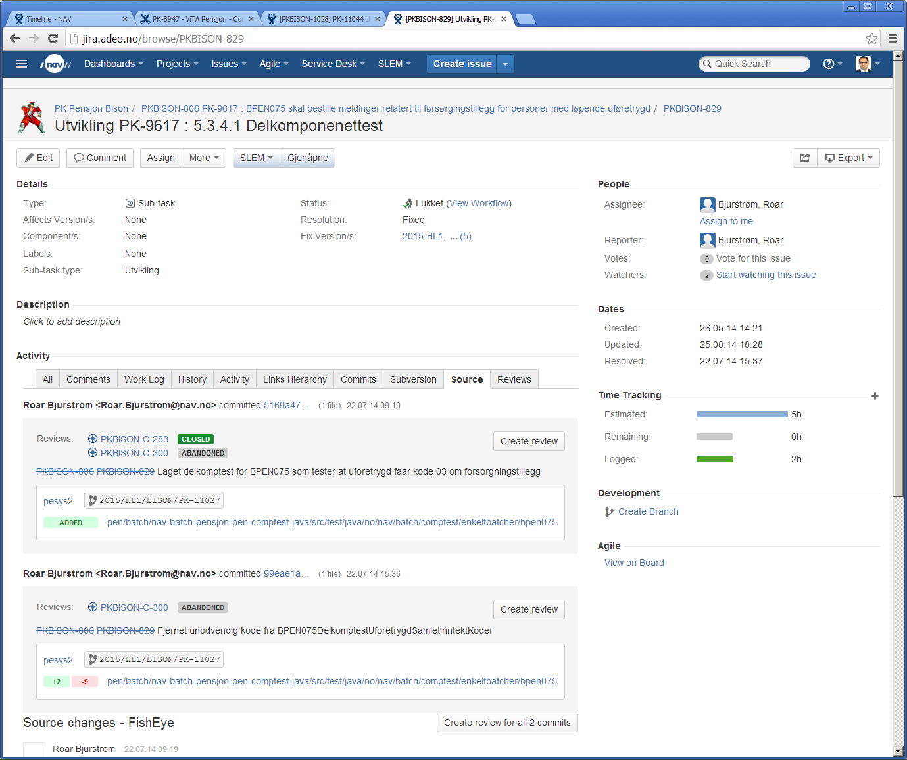
Additional delivery practices contd.
Jira pic with crucible revie

Slide 14
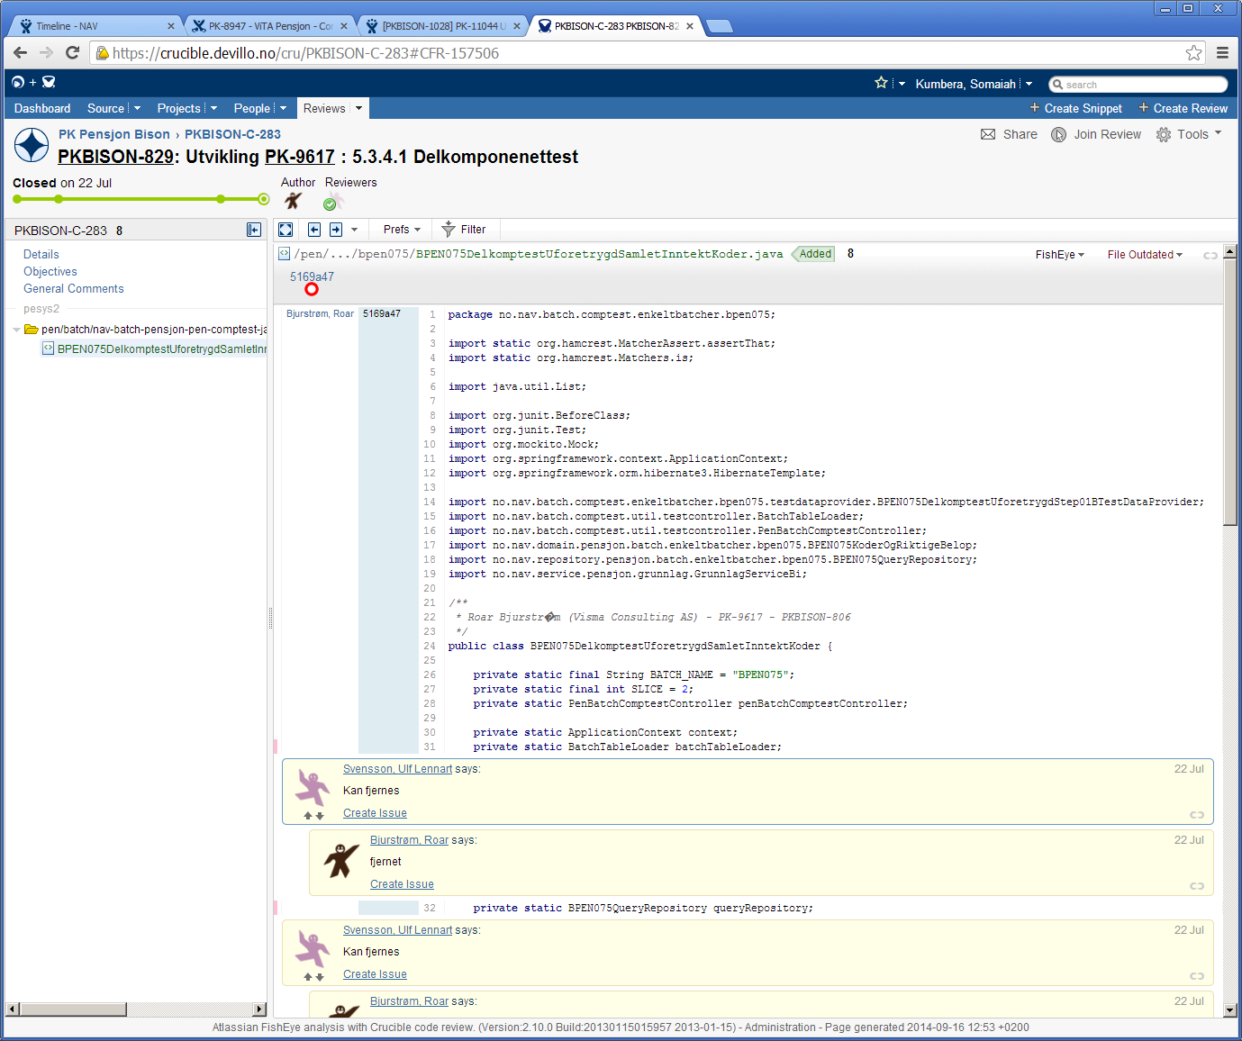
Additional delivery practices contd.
Crucible review

Slide 15
Further reading
- https://dropwizard.github.io/dropwizard/manual/core.html
- http://mongojack.org/
- https://www.owasp.org/index.php/REST_Security_Cheat_Sheet
- http://www.thoughtworks.com/radar/techniques/rest-without-put
- http://martinfowler.com/articles/microservices.html
Tolerant reader
Consumer driven contracts
- https://github.com/somaiah/phrasefinder.git

